Slide 1

Chicago Reported Incidents Dataset
CIS 4560-01 | Group 3
Jerry Petty, Mayowa Toyinbo, Erik Pacheco, Francisco Figueroa, Eric Ventura, Gerardo Camarena

Slide 2

Data Description/Source
Data Name: Chicago Crime (01JAN2001-22JUL2020)
Source: Chicago P.D.
Size: 1.7GB Format: CSV
Dataset URL: https://www.kaggle.com/datasets/n3v375/chicago-crime-from-01jan2001-to-22jul2020
Github URL: https://github.com/FranXavier12/Tempo-Spatial-Analysis-of-Chicago-Crime-Data
Description: This data records incidents of crime recognized by the Chicago Police Department. It includes location, time, and the categorial reasoning for each incident.

Slide 3
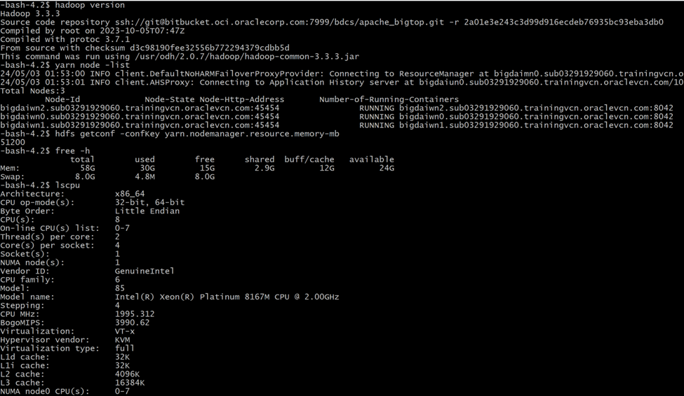
Specifications
Cluster Version: Hadoop Cluster 3.3.3
Number of Nodes: 3 nodes (1 Master, 2 Worker)
Memory Size:
Master Nodes: 51.2GB RAM
Worker Nodes: 58GB RAM each
CPU Speed: 1995.312 MHz
Our cluster is running Hadoop version 3.3.3, consisting of 3 nodes (1 Master and 2 Worker), with the master node having 51.2GB of RAM and each worker node having 58GB of RAM. The CPU speed is approximately 2.00 GHz.

Slide 4
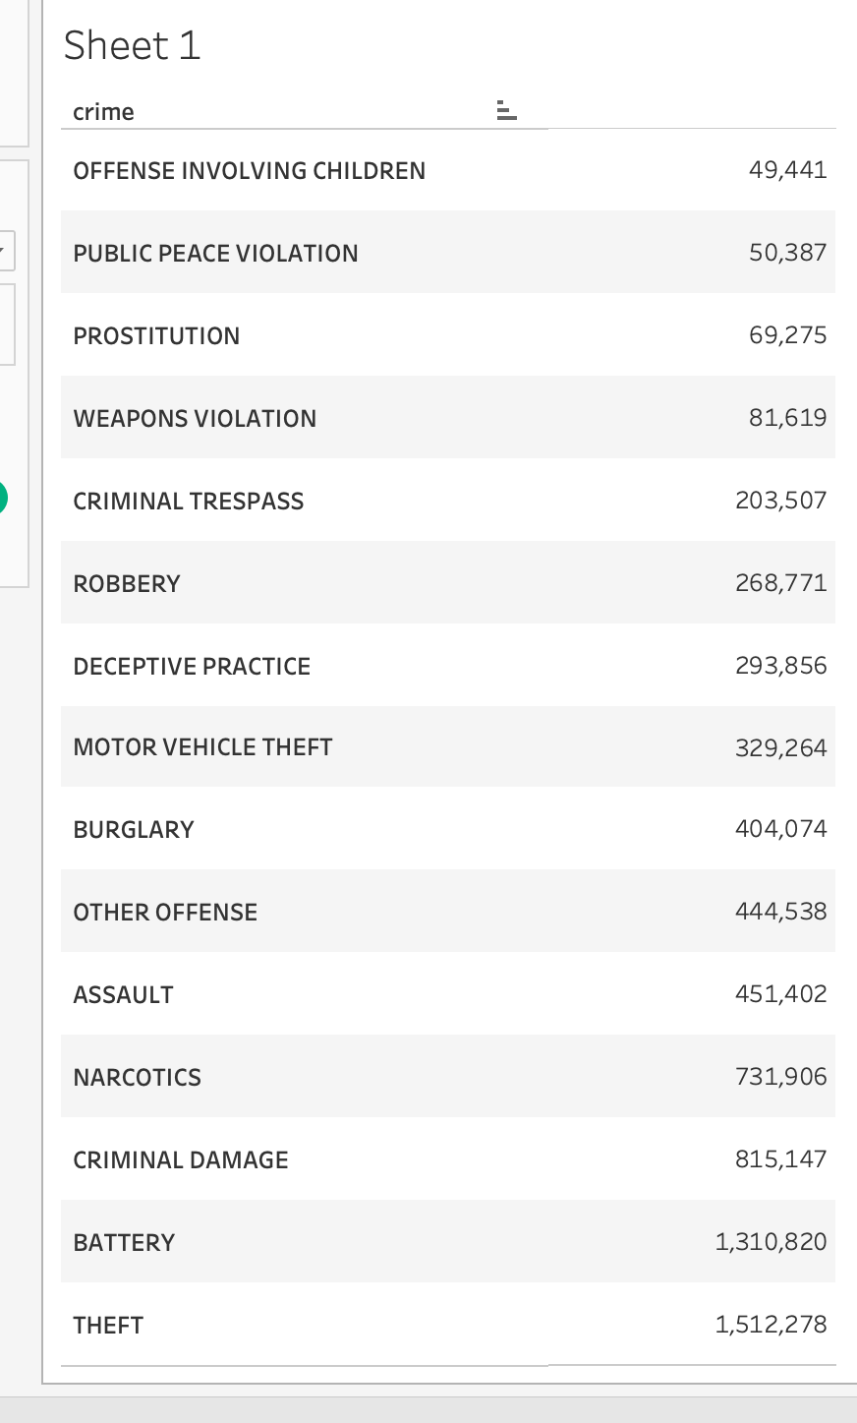
Top 15 Crime Incident Types
This table provides insights into the top 15 crime types reported in the Chicago Police Department dataset.
Analyzing the distribution of crime types helps identify prevalent issues in the city.

Slide 5
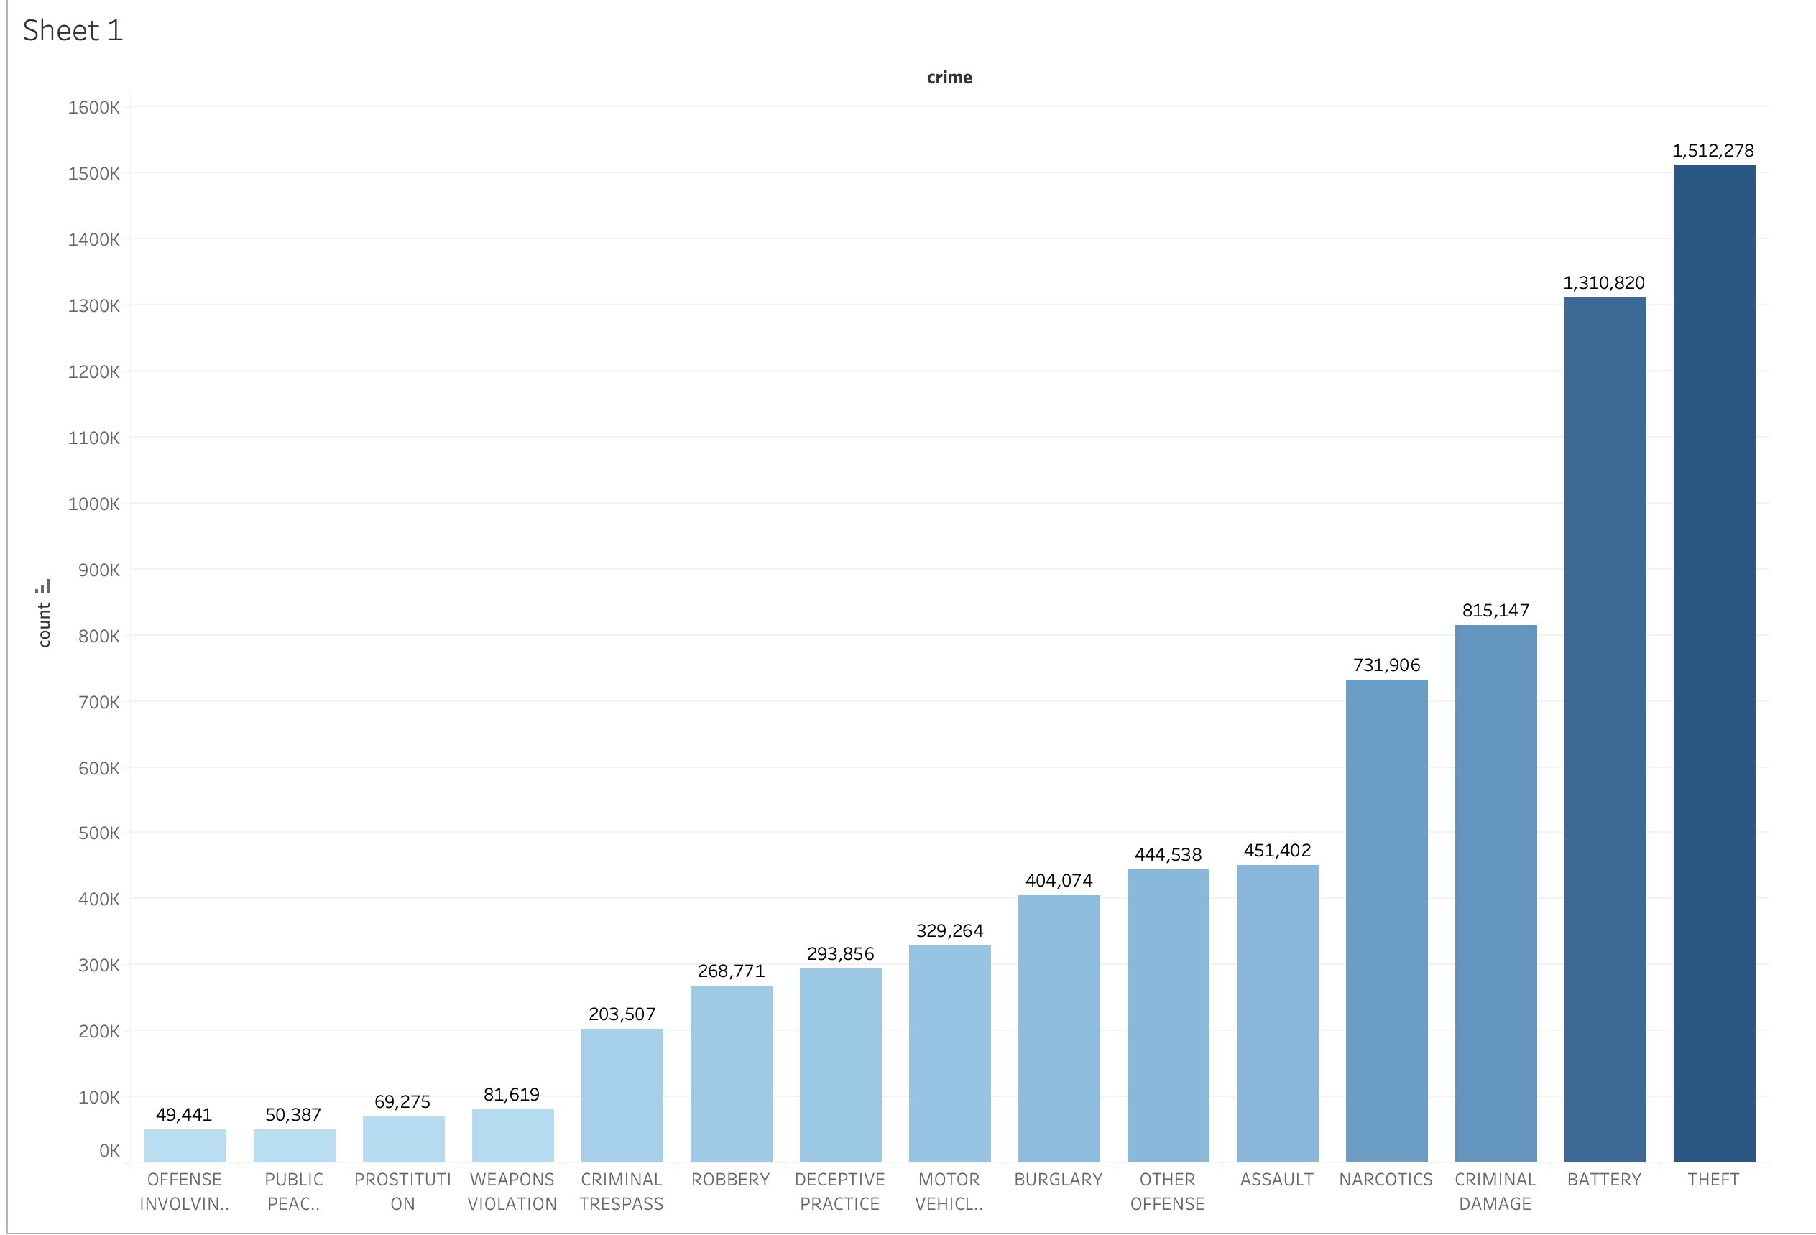
Top 15 Causes of Incidents Visualization

Slide 6
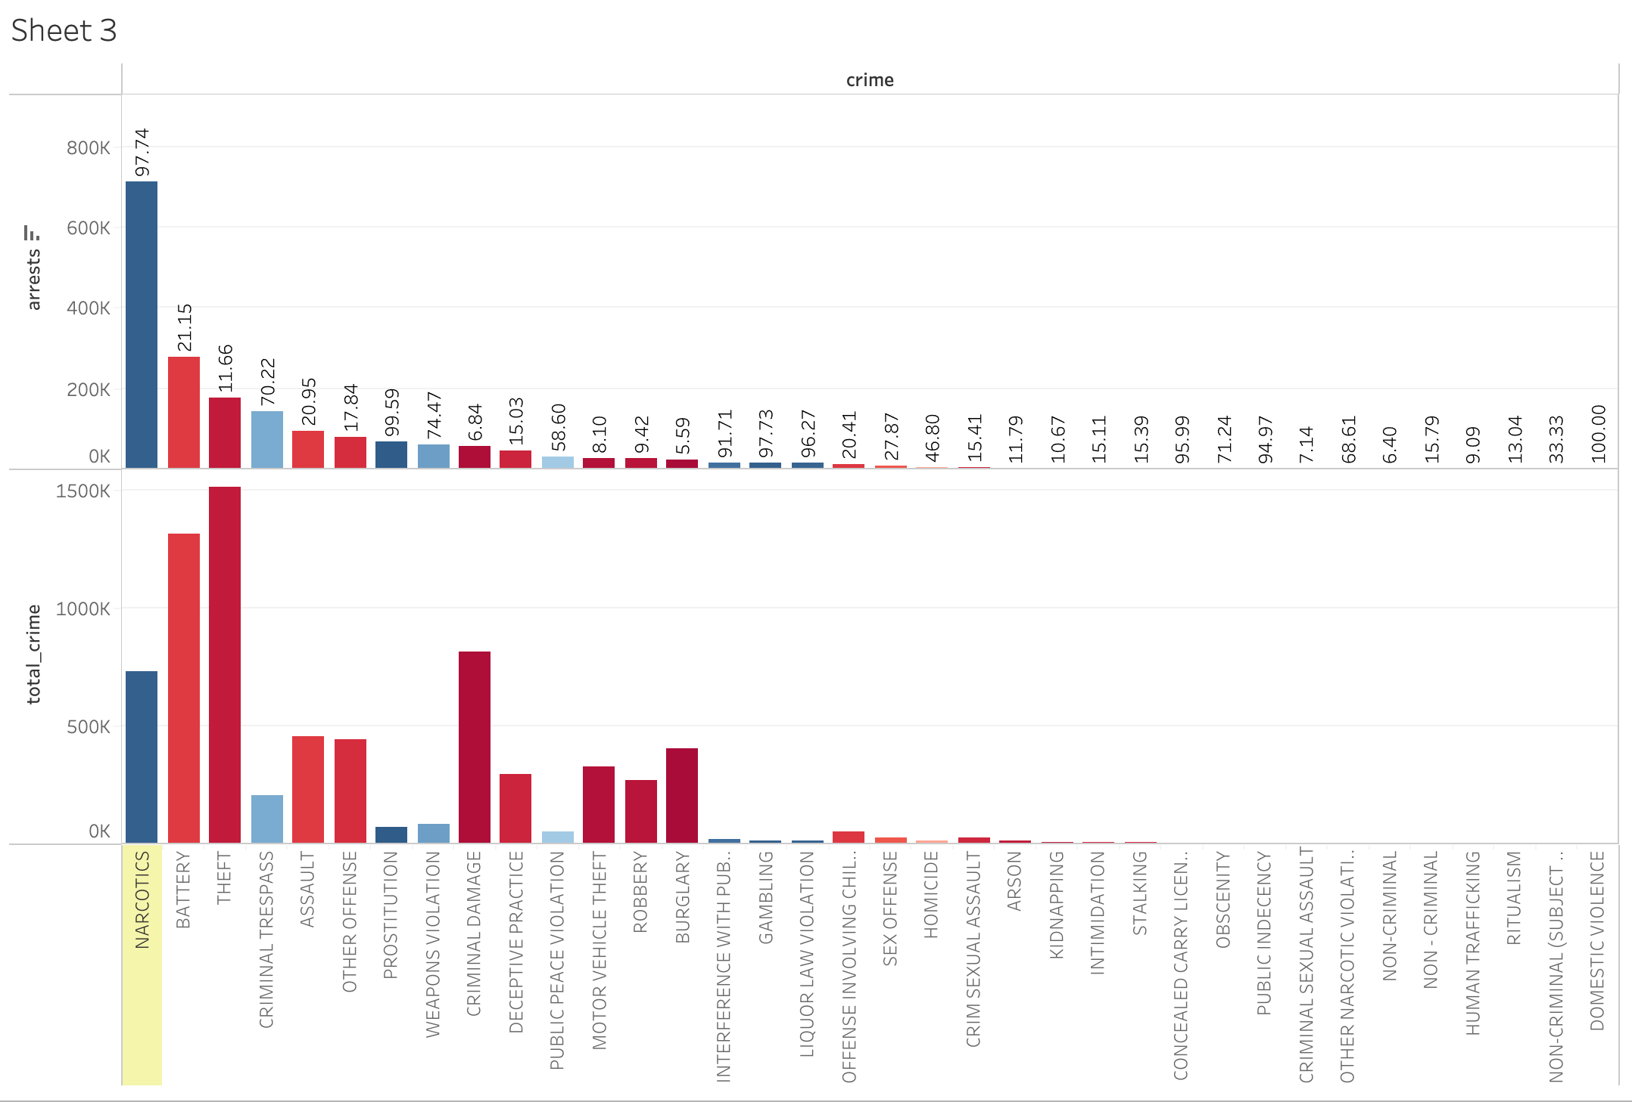
Arrests Analysis by Crime Type
This bar chart compares the crimes reported to arrests made. This allows us to understand the types of crimes that result in arrests.
The ratio of ‘arrests made’ to ‘crimes reported’ is also shown in percentages.

Slide 7
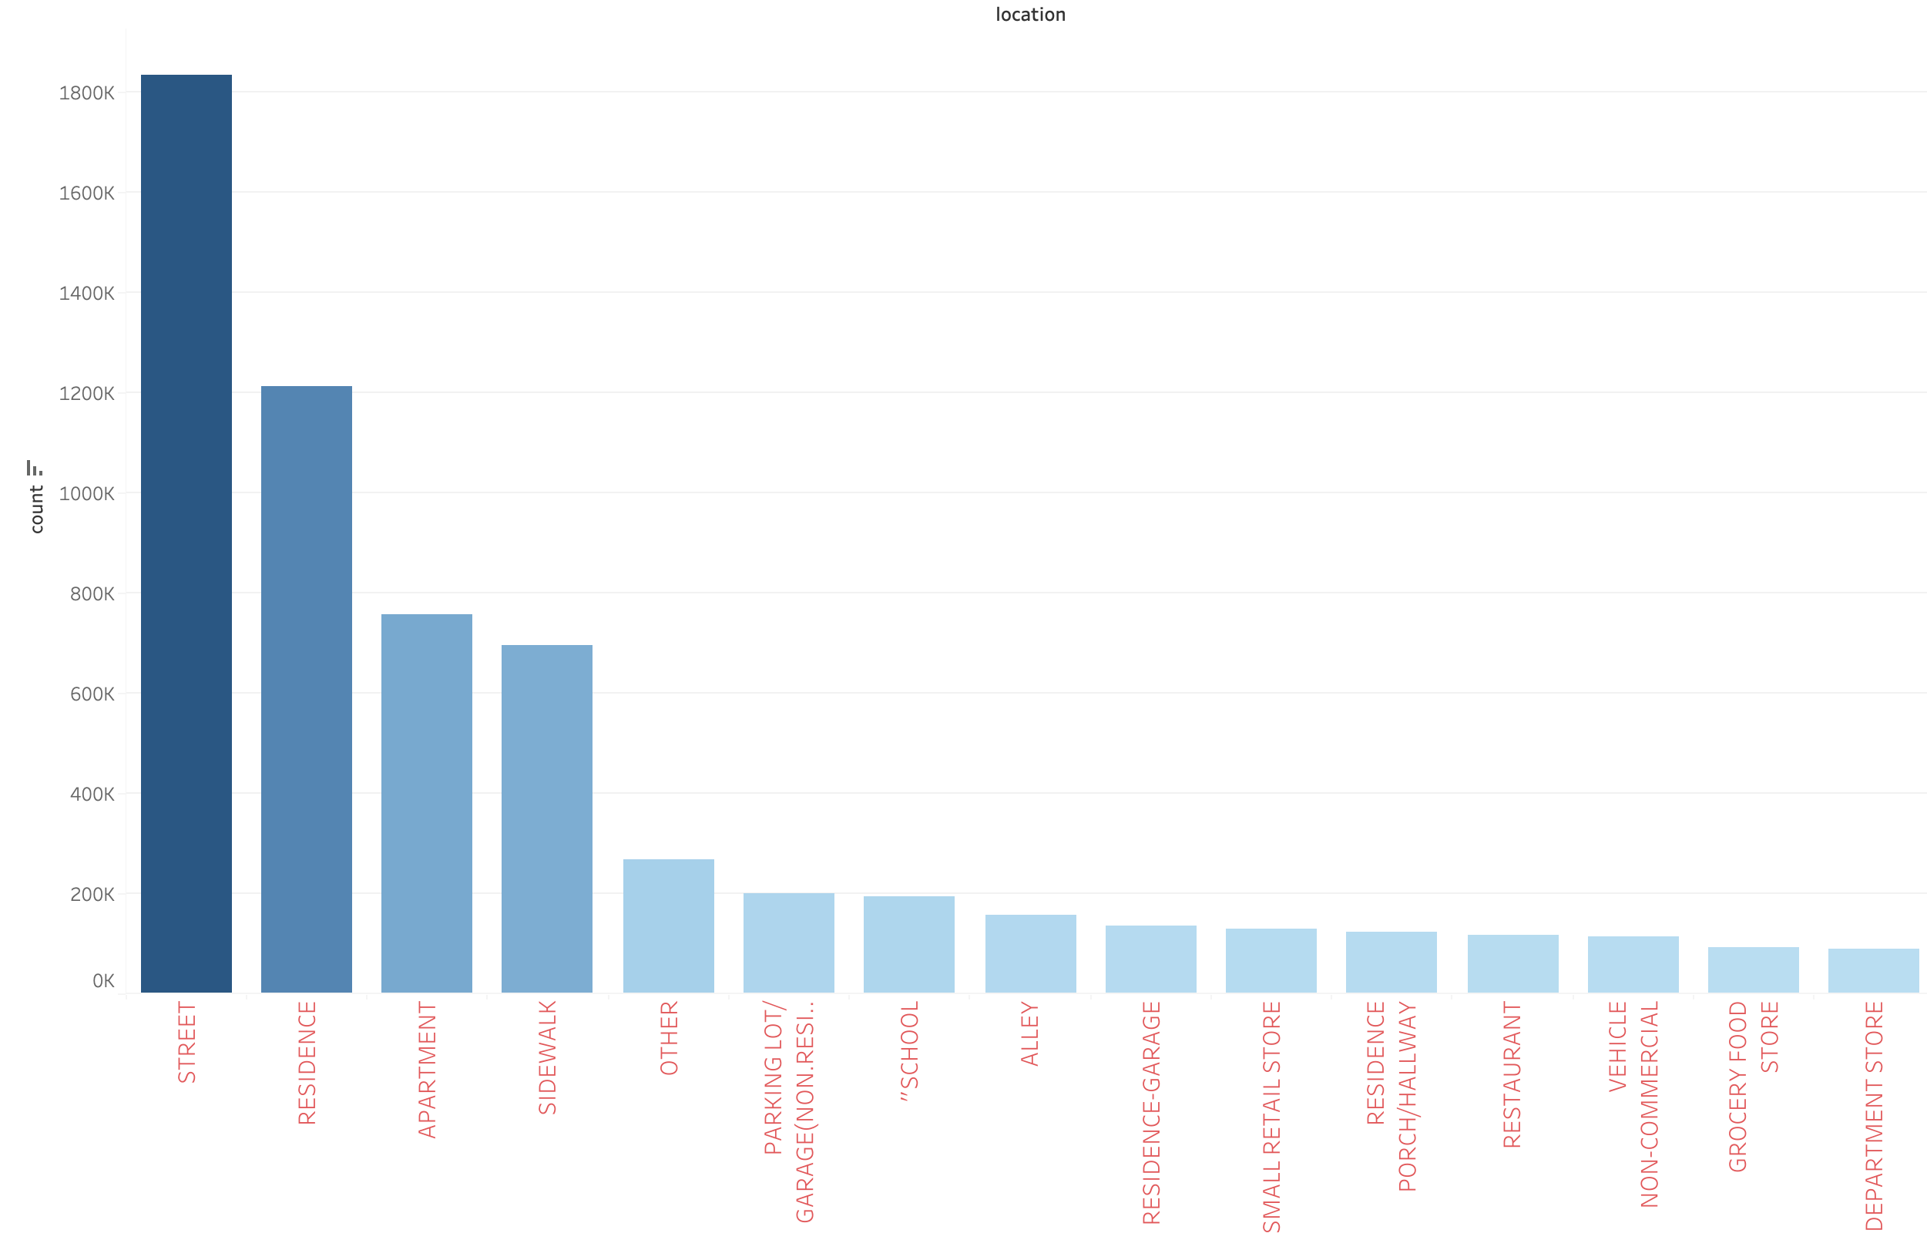
Crime by Location

Slide 8
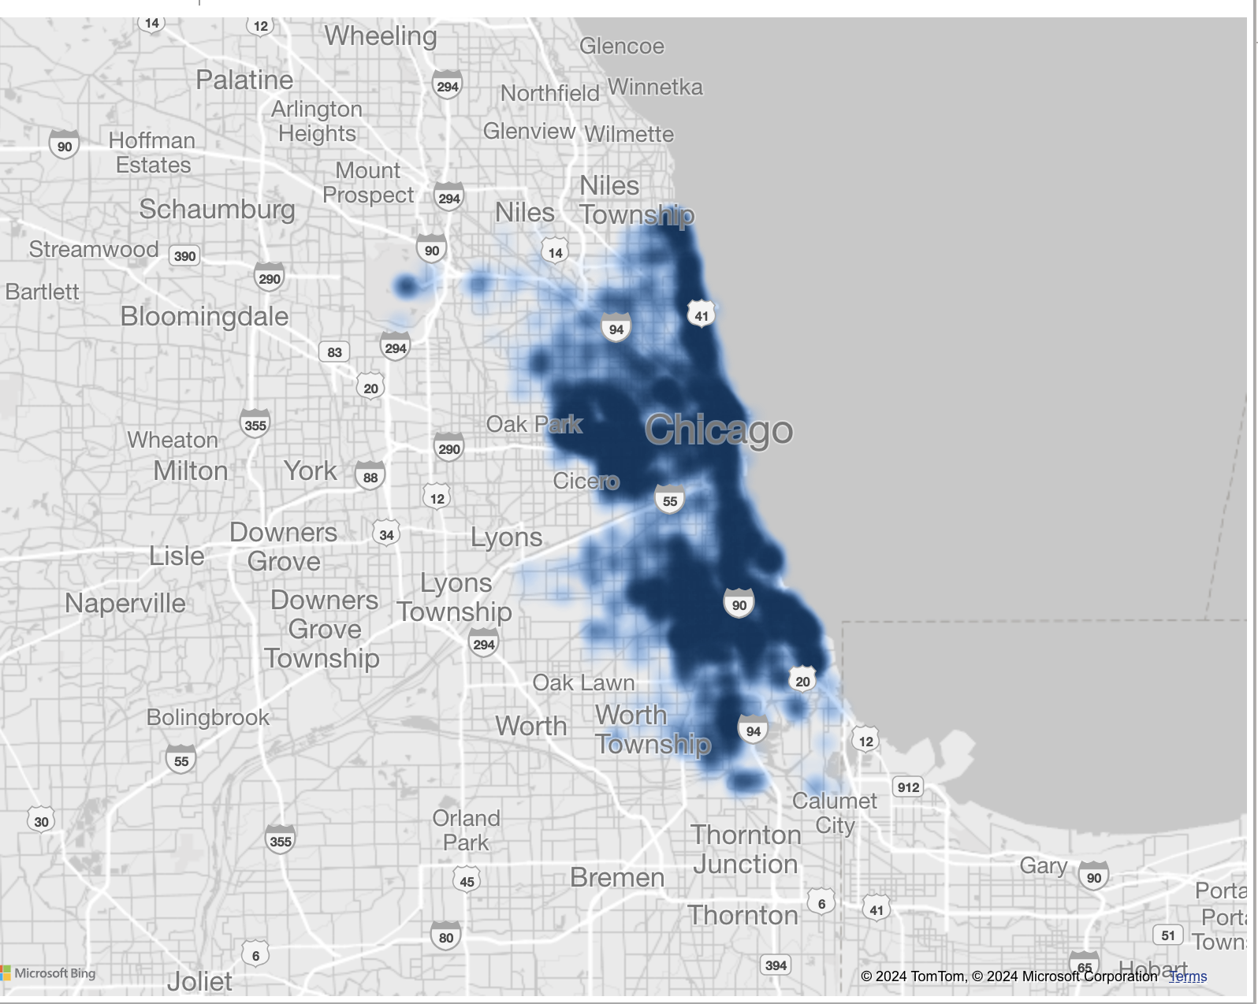
Geo-Spatial Analysis Heatmap

Slide 9
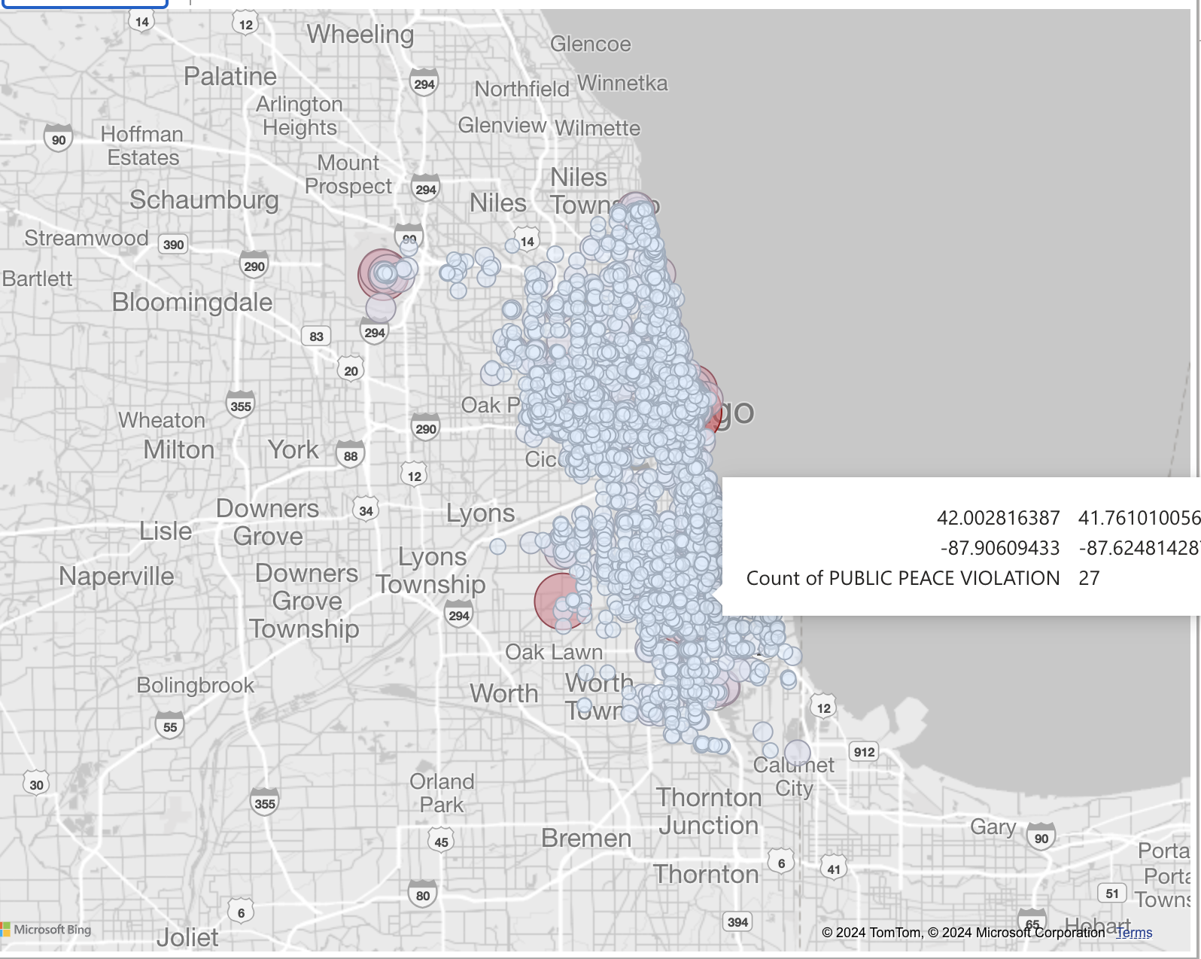
Geo-Spatial Analysis Bubbles

Slide 10
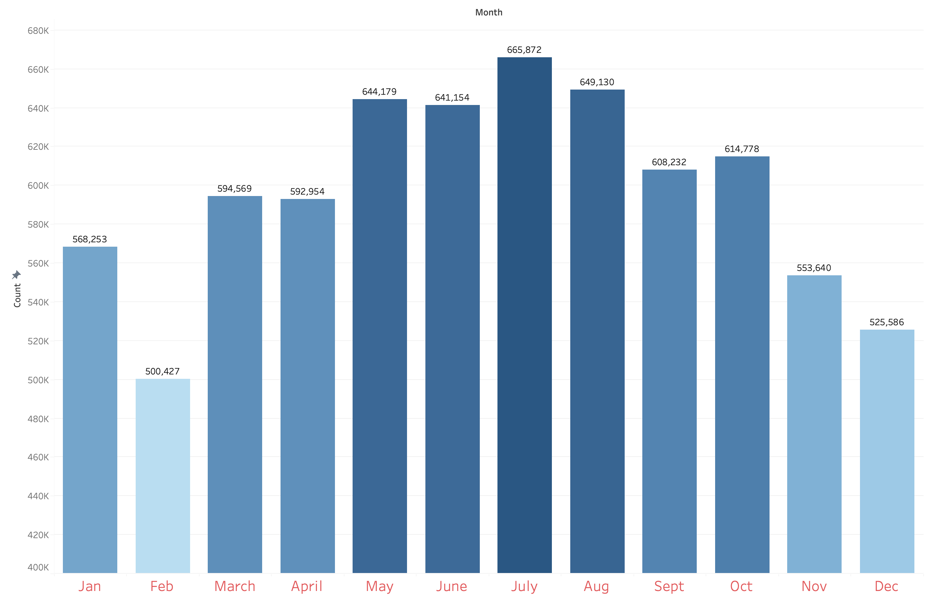
Temporal Analysis Crime Count by Month
This Chart compares the reported crimes each month, providing insights into the unresolved issues across Chicago.

Slide 11
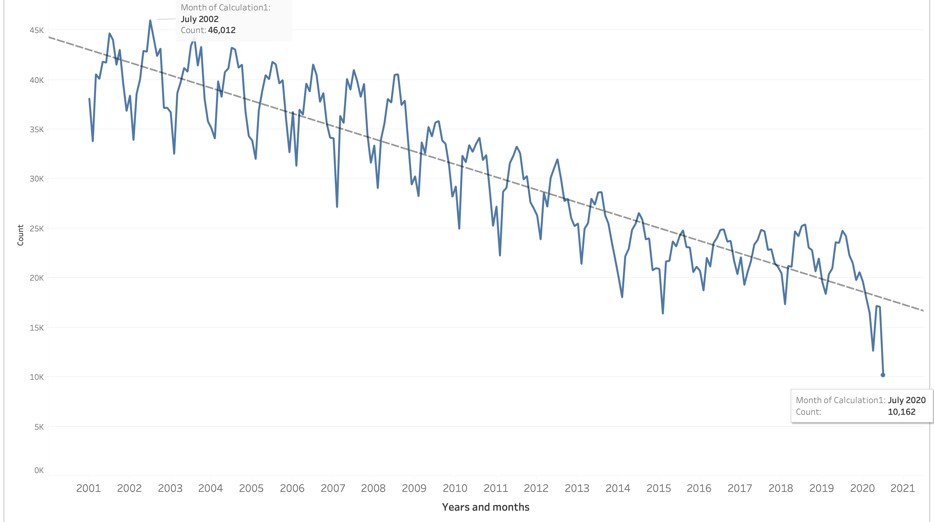
Temporal Analysis Crime Count by Year
This slide presents a temporal analysis of crime in Chicago from 2001 to 2020.
A peak in crime incidents is observed in July 2002, with a count of 46,012 reported cases.
Despite fluctuations, there is an overall trend of declining crime rates over the observed period.

Slide 12
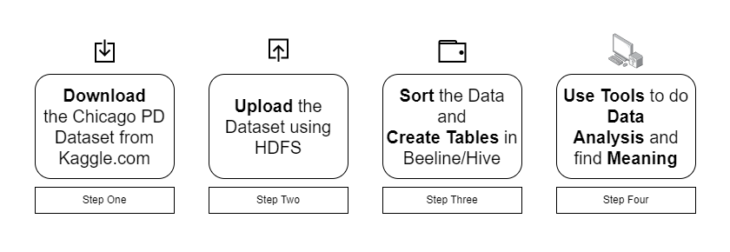
Implementation Flow Chart

